Slide 1
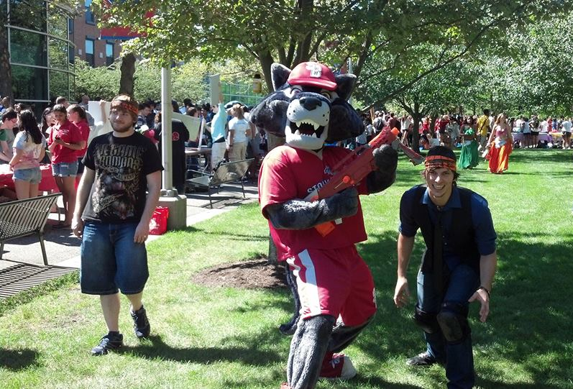
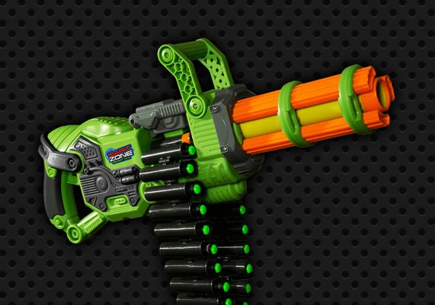
HUMANS VS ZOMBIES
Fall 2018

Slide 2
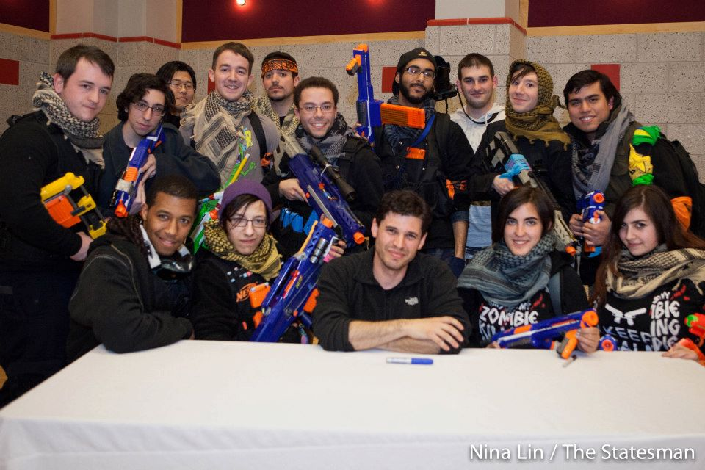
What is Humans vs. Zombies
A game of organized tag played between two opposing teams.
The game starts Wednesday October 31st at 11.55PM.
Game starts here
Oct 31
Nov 1
11:55

Slide 3
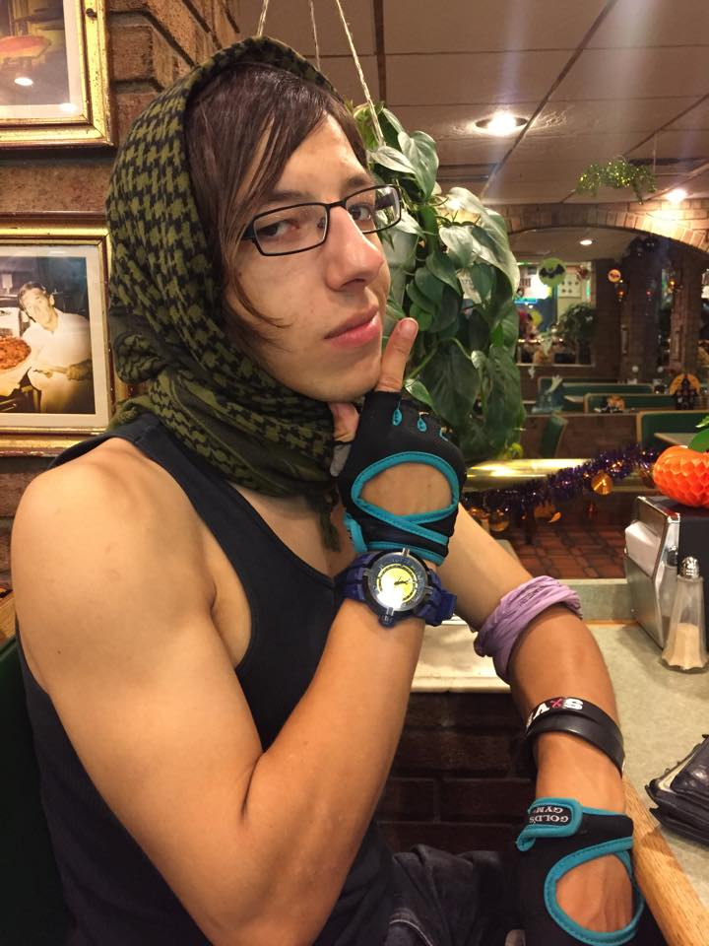
What is a human?
Players start the game as human, other than Original Zombie.
Humans denoted by the SBHvZ bandana on upper arm.
Humans may stun zombies using a moderator-approved blaster, clean socks or thrown darts. No intentional headshots!
If a human is tagged, they become a zombie player

Slide 4
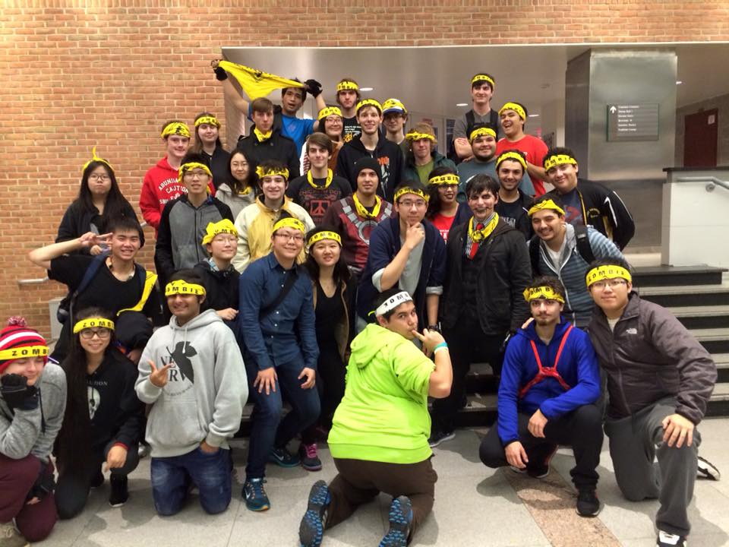
What is a zombie?
Zombies wear bandana around their forehead when active, around neck when stunned (exit gameplay/take T-pose)
T-pose!
Zombie players may not carry blasters or pick up darts.
Stunned by humans with darts and/or socks
When a zombie tags a human player they must take their kill code. If they fail to the kill is null and void.

Slide 5
What is the Original Zombie
The game starts with a singular zombie known as the original zombie
The original zombie is dressed as a human player and is not stunnable until they make their first tag.
For 10 minutes after their first tag they are allowed to continue to look as a human, after which if they have yet to be stunned by a player they must put their bandana on their head.
Players must enter the raffle to be considered to be the original zombie and the OZ will be contacted by the mods before the game starts

Slide 6
How to give people your kill code

Slide 7
Stuns and Incubation
A stun is when a zombie players is hit with a dart or a human player is either hit by a dart or tagged by a NPC
    12:01AM - 5:59PM: 10 minutes
    6:00 PM - 12:00 AM: 5 minutes
Incubation is when a human player is tagged by a Zombie during the game
  15 minutes
  Night Mission only: go to SAC, or wherever the kiosk mod is stationed, to drop your belongings

Slide 8
What is a moderator
Moderators wear a safety green shirt
There are three different types of moderators ( Mobile mods, Kiosk mods, and NPC moderators)
The mobile moderators enforce gameplay rules, and also settle tag disputes.
Kiosk mods stay in the SAC kiosk, their purpose is to answer questions throughout the day and to make sure people can leave their things In the sac during a night or day mission
But what’s an NPC moderator

Slide 9
NPCs
GENERAL NPC MECHANICS:
NPCs can be neutralized in a variety of ways.
Denoted by white mod bandana. Human NPCs wear their bandana on the arm; zombies, on the forehead. They will not be wearing their Highlighter yellow mod shirt
Human NPCs can stun both human and zombie players
Zombie NPCs can stun/kill human players
LISTEN DURING MISSION BRIEFINGS FOR MORE INFO ON NPC SPECIFICS.

Slide 10
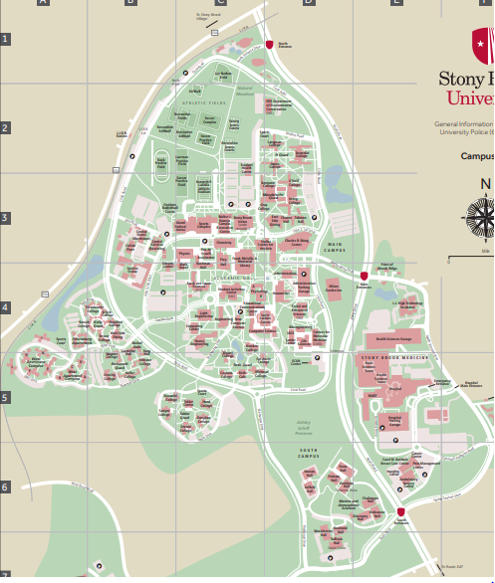
PLAY AREA!!!!
RED IS NOT PLAY AREA
Avoid big parking lots
Avoid streets

Slide 11
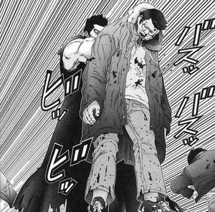
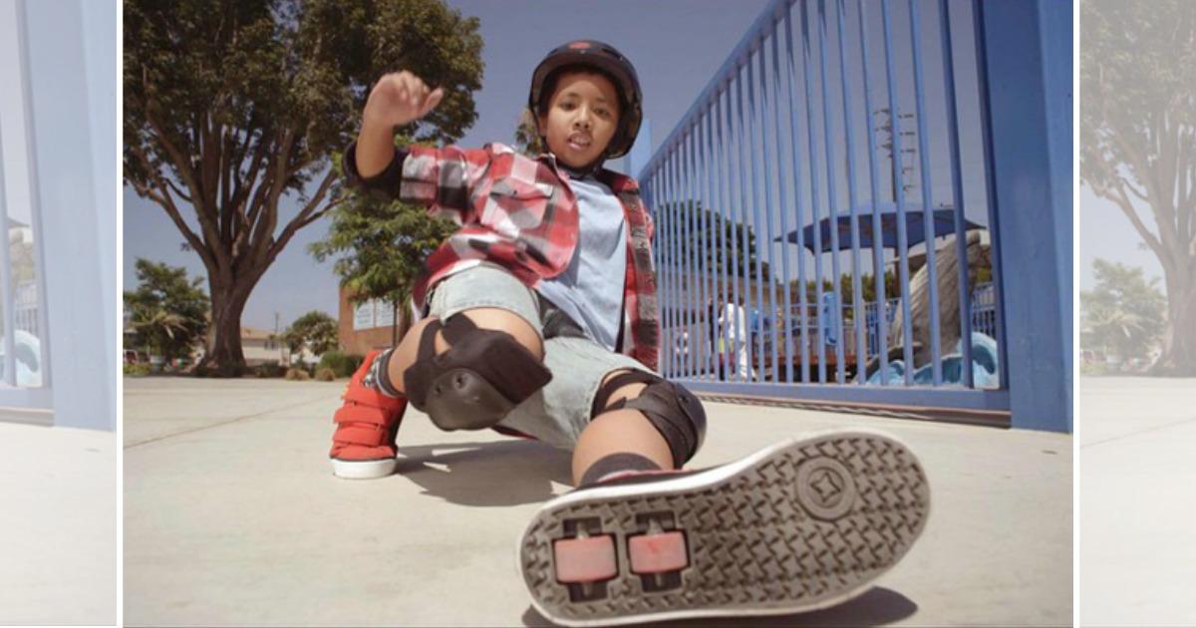
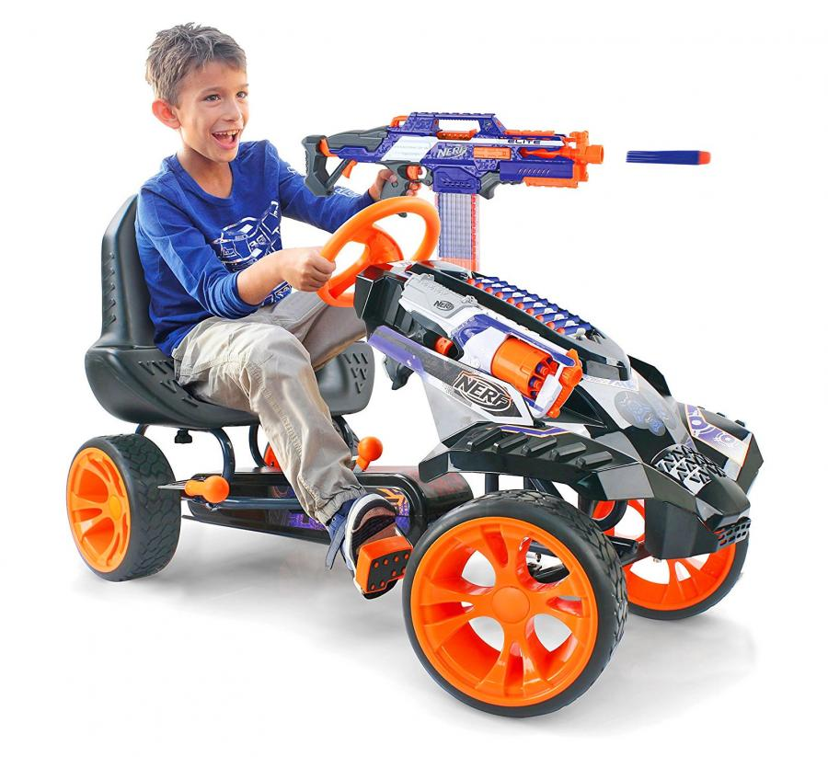
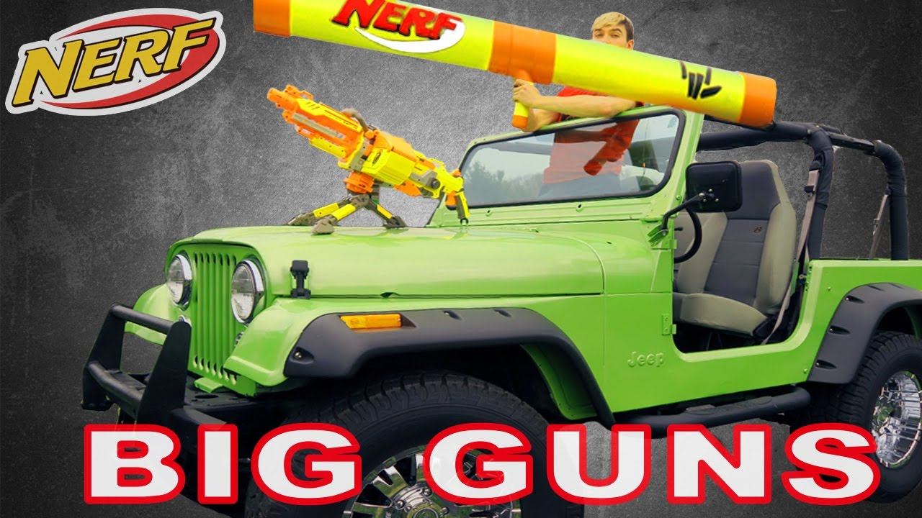
General Rules and safety
Players must follow all NYS laws and school regulations.
All players must have their bandanas and IDs with them at all times while in play. Bandanas cannot be obstructed from view.
Do not bother the non-players, and no using them for shield/assistance!
NO VEHICLES OF ANY KIND
No play indoors, blasters must be concealed at all times while in a building.

Slide 12
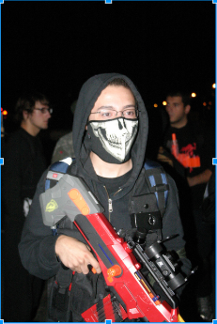
General Rules and Safety, continued
Do not conceal blasters in tactical apparel.
No face wraps or masks (can paint but must be identifiable)
No climbing or jumping off anything higher than your chest
Rule 6: Don’t be a Dick
X

Slide 13
Strikes
X
Strikes are given for unsafe or unsportsmanlike gameplay is strikeable at a moderator’s discretion.
CATCH-ALL RULE: moderators reserve the right to make new rulings on unforeseen scenarios which violate the spirit of the game.
If you receive three strikes, you are banned from the current game.
X
X

Slide 14
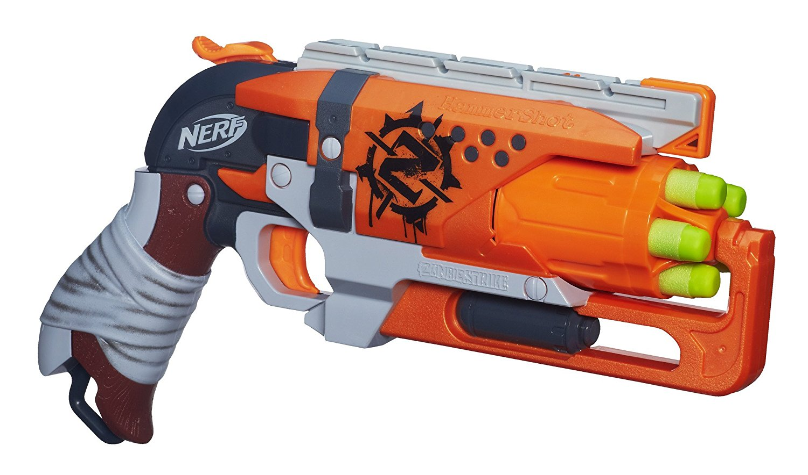
Equipment Checks
All blasters must be approved by a moderator and given a ziptie.
No hard-plastic-tip darts
Socks must be empty, but can be held together with one rubber band or a single wrap of electrical tape.
Blasters must not be painted in an overly realistic manner; tips must remain blaze orange (NYS law)
Nothing smaller than a Hammershot → → → → → → → → →
Velcro-tipped darts may not be fired out of blowguns.
NO MELEE WEAPONS
“But what about brawl weapons”
Tom 2015-2018

Slide 15
Door Zones
The area within five heel-to-toe steps of a door is considered a safe zone. Safe to load and unload blasters.
NO SAME-DOOR TAGS
Door zones are safe for both humans and zombies.
Door zones are not active during night missions.
Camping door zones is a strikeable offence.
Bus stops are considered door zones when the bus is there and the doors are open.

Slide 16
The Store
Human and zombie players receive tickets for going to missions, turning players into zombies, etc.
The amount of tickets for each event goes as follows
  Day mission 5 tickets, Night mission 10 tickets, 1 Kill = 5 tickets
These tickets are used in order to buy perks from our store

Slide 17
Missions
Missions are announced via text and e-mail, and are divided into three types:
  - Main: Large scale missions covering the entire campus.
  - Side: Smaller missions meant to be quicker.
  - Secret: Small, hidden missions with special rewards
Keep in mind that some
objectives can shorten or unlock other missions.

Slide 18
NIGHT ZERO MISSION
Mission at 11:55 PM for all players on October 31, 2018
Stun timer is 5 minutes for zombies
Incubation - Go to library commuter lounge
Rewards will be given for showing up and completing the mission
Come at your own risk!

Slide 19
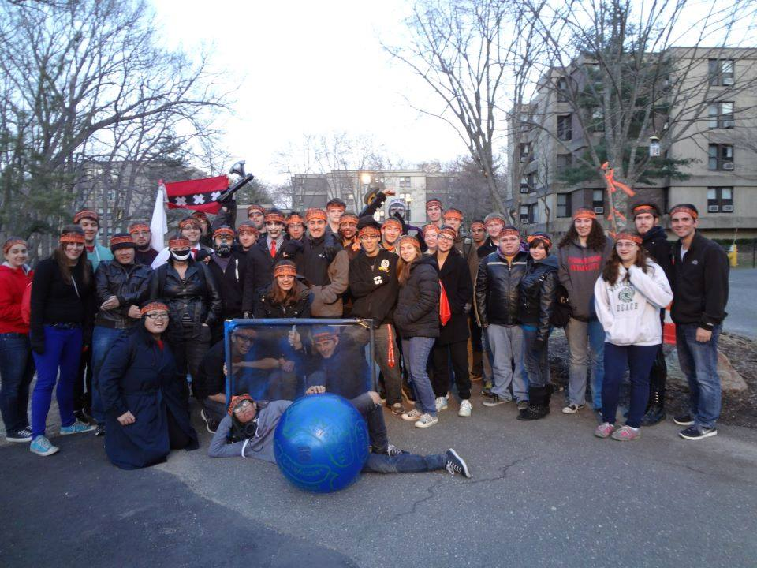
Have fun!
ANY QUESTIONS?
Ask us or find us at:
www.sbhvz.com
www.facebook.com/groups/stonybrookhvz
SAC KIOSK

Slide 20
LIKE OUR PAGE and FOLLOW OUR INSTAGRAM
FACEBOOK
https://www.facebook.com/SBUHumansvsZombies/
INSTAGRAM NAME
sbhvz

